Slide 1
ESCC with microarray
CCLE_GSE36133

Slide 2
Getting the data from GEO

Slide 3
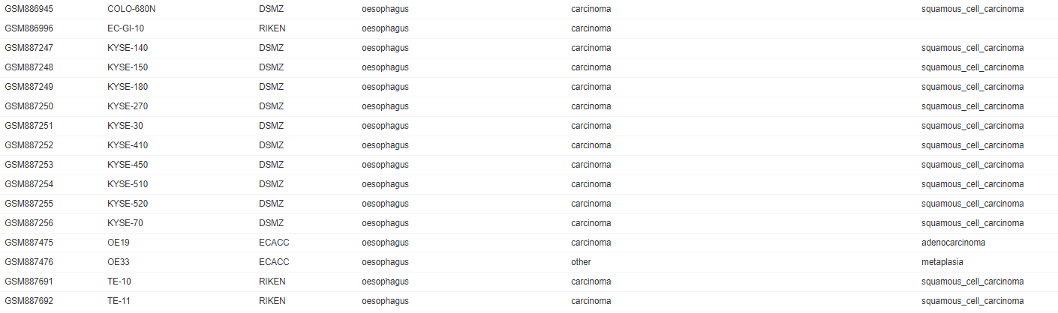
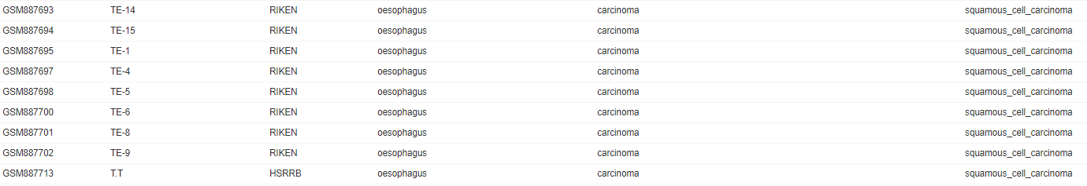
ESCC in CCLE – GSE36133
Notes:
22 SCC vs the 3 others

Slide 5
Lung cancer data – GSE36133
In the paper, it means classification of 88 NSCLC
In the download data from GEO
ADC: adenocarcinoma (44)
ADSC: adenosquamous cell carcinoma (51), “small cell carcinoma??”
LCC: large cell carcinoma (11)
NSCLC: non-small-cell carcinoma (24)
Others: all other types (13)
SCC: Squamous cell carcinoma (23)

